Slide 1

Optimizing Human-AI Interaction through Advanced Context Management

Slide 2

1 Strategic Approaches to Context Window Management for Enhanced AI Performance

Slide 3

Efficiently managing context windows for optimal AI processing and recall
1
2
3
4
Normal context handling
Context Window Optimization Strategies
Enhanced AI Interaction through Context
Strategic Context Management for AI
Implementing standard procedures for managing the context window, ensuring consistent performance and reliable information processing across various AI interactions.
Exploring advanced techniques for maximizing the utility of the context window, ensuring efficient AI processing and improved information recall pertinent to the user's query.
Optimizing human-AI interaction by strategically managing context windows, leading to more coherent and relevant AI responses and improved user experience.
Applying strategic approaches to context window management to enhance AI performance, focusing on efficient data handling and improved recall capabilities.

Slide 4

Implementing dynamic context resizing to adapt to varying conversational depths
Adaptive Context for Better Interaction
Adaptive Context for Enhanced Performance
Typical context adjustment
Facilitating more natural and effective human-AI interaction by implementing dynamic context resizing, allowing the AI to fluidly adapt to conversational nuances.
Employing strategic dynamic context resizing to enhance AI performance, ensuring adaptability to varying conversational depths and maintaining relevance.
Utilizing conventional methods for adjusting the context window size, ensuring a stable and predictable response to changes in conversational depth.

Slide 5

Prioritizing critical information within the context window for relevance
Standard information prioritization
Strategic Prioritization for AI Relevance
Applying standard protocols for prioritizing information within the context window, ensuring a consistent and reliable approach to data relevance.
Implementing strategic prioritization of critical information within the context window to enhance AI performance and ensure the highest degree of relevance in its outputs.
Critical Information Prioritization
Focused Context for Optimal Interaction
Establishing robust mechanisms for prioritizing critical information within the context window, thereby enhancing the relevance and accuracy of AI responses.
Improving human-AI interaction by focusing the context window on critical information, leading to more precise and relevant AI outputs.

Slide 6
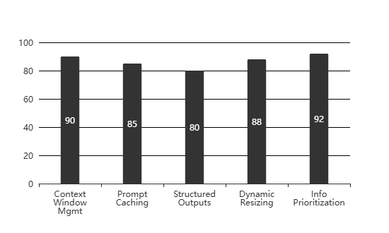

Context Engineering Strategies
Key Strategies for Optimized AI Context Management(Effectiveness Score (%))

Slide 7
2 Leveraging Prompt Caching Techniques for Accelerated AI Response Generation

Slide 8


Implementing prompt caching to reduce latency in repetitive AI interactions
Normal prompt caching benefits
Managing context for efficiency
This subtitle discusses the standard advantages of prompt caching, such as improved response times and reduced computational load, a normal aspect of optimization.
This subtitle explores how effective context-window management directly contributes to reducing latency in AI interactions, aligning with the user's focus on context engineering.

Slide 9

Optimizing cache invalidation strategies for up-to-date prompt retrieval
Maintaining interaction accuracy
This subtitle examines how effective cache invalidation strategies are vital for maintaining the accuracy and reliability of human-AI interactions.

Slide 10

Utilizing prompt templates with caching for consistent and rapid outputs
Enhancing interaction consistency
This subtitle details how prompt templates and caching contribute to a more consistent and predictable human-AI interaction experience, aligning with the theme.
Structured outputs with templates
This subtitle explores how combining prompt templates with caching facilitates structured outputs, a key component of advanced context engineering practices.
Consistent accelerated AI output
This subtitle emphasizes how prompt templates, when cached, lead to consistent and rapid AI response generation, directly supporting the catalogue's objective.

Slide 11
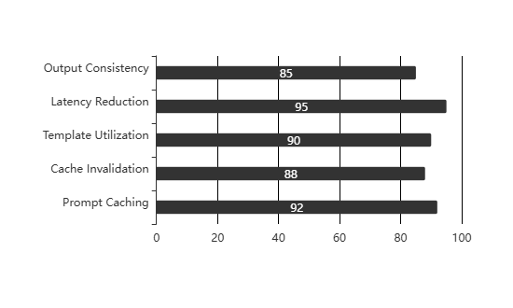
Prompt Caching Strategies for AI Interaction Optimization
Effectiveness of Prompt Caching in AI Systems(Effectiveness Score (%))

Slide 12
Thank You

